Slide 1


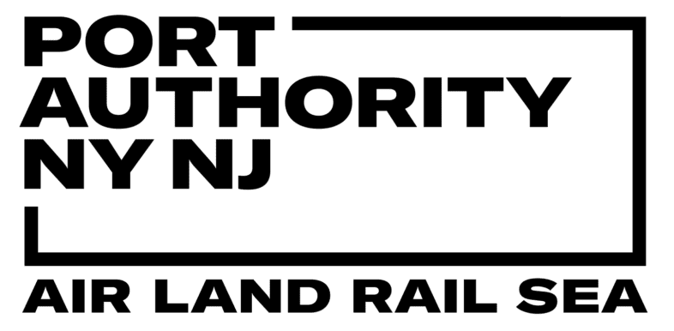

Final Project Progress Report
Group 1: Giacomo Bizzotto, Anyuta Choudhary, Murali Bellapu,Naga Sai Harika Mangina, Sivaram Vangavolu

Slide 2
Question 1: Top Five Factors Affecting Usage
Our analysis identified the most significant drivers of traffic levels across Port Authority facilities, crucial for operational planning.
1. Facility
2. Week of the Year
3. Holiday Status
Characteristics, location, and capacity of each bridge or tunnel.
Broader seasonal cycles, including tourism and weather changes.
Alters commuting: reduced work travel, increased leisure movements.
4. Month
5. Day
Provides additional monthly seasonality context.
Captures daily traffic fluctuations and calendar effects.

Slide 3
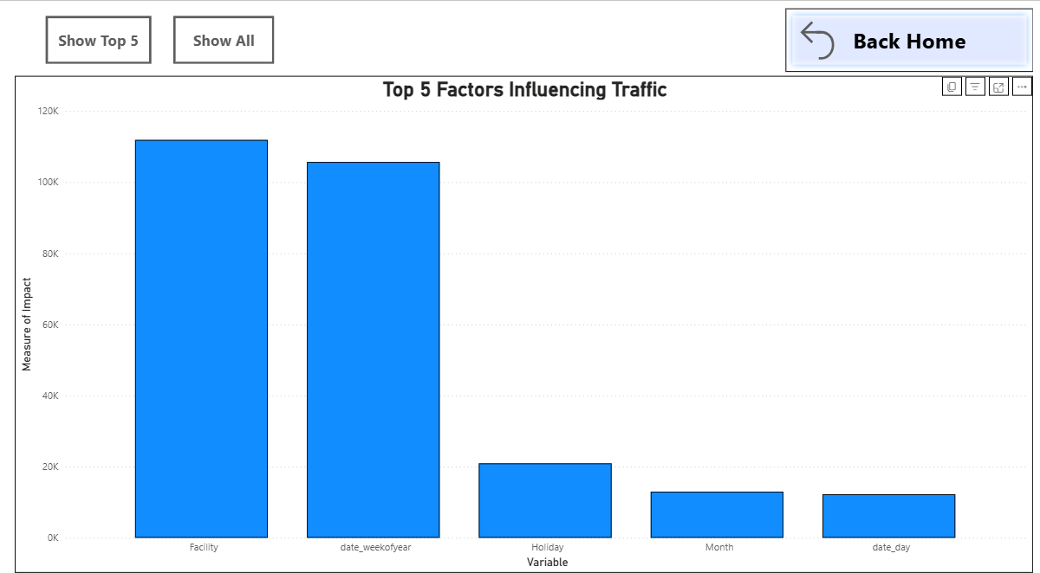

Slide 4
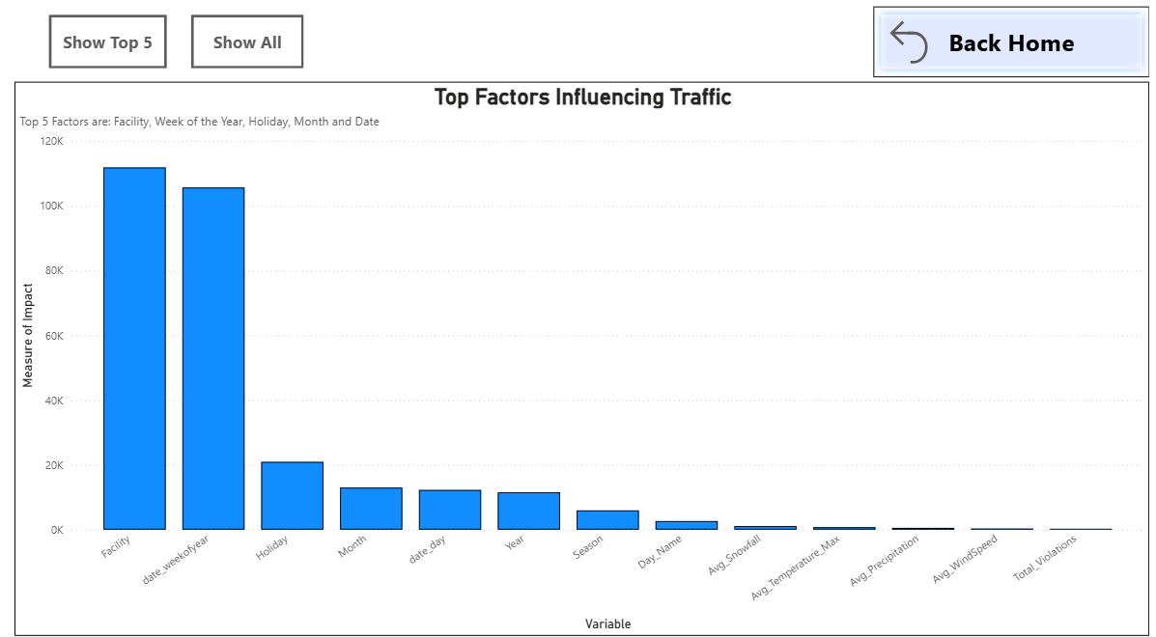

Slide 5
Toll Violations Analysis
Key patterns from 2013-2024 toll violation data.
Total Violations (2013-2024)
Key Trends
81.1 Million
Surge (2019-2020): Sharp increase, peaking mid-2020.
Post-2020: Levels remain high vs. pre-2019.
Daily Peaks: 6 AM - 6 PM (peak traffic).
Significant financial & operational challenge.
Top Facilities: Holland Tunnel, GWB (PIP & Upper).
Recommendation: Focus enforcement on high-violation facilities and peak hours.

Slide 6
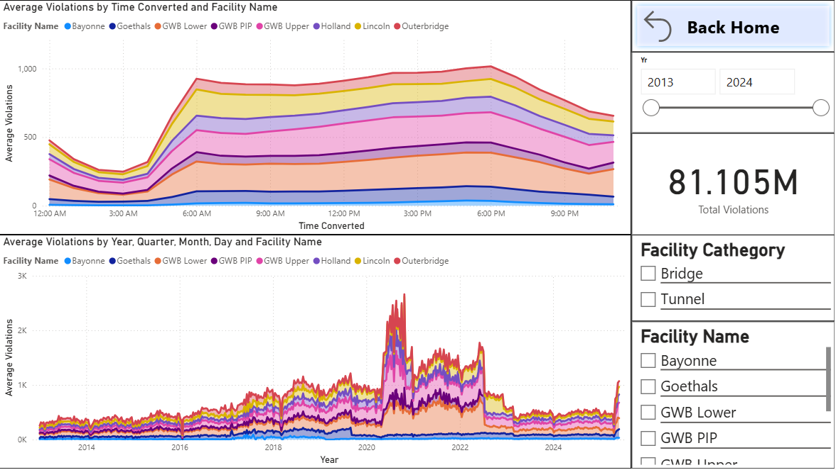

Slide 7
Question 3: Busiest Times & Impact of Key Factors
1
Peak Hours: 6am – 6pm with evening Peak: 4-6 PM
2
Busiest Day: Friday (~0.31M vehicles)
3
Peak Months: July, Aug, Oct: >10M vehicles
4
Toll Violations: Highly correlates with traffic
5
Holidays: Reduce commuter traffic

Slide 8
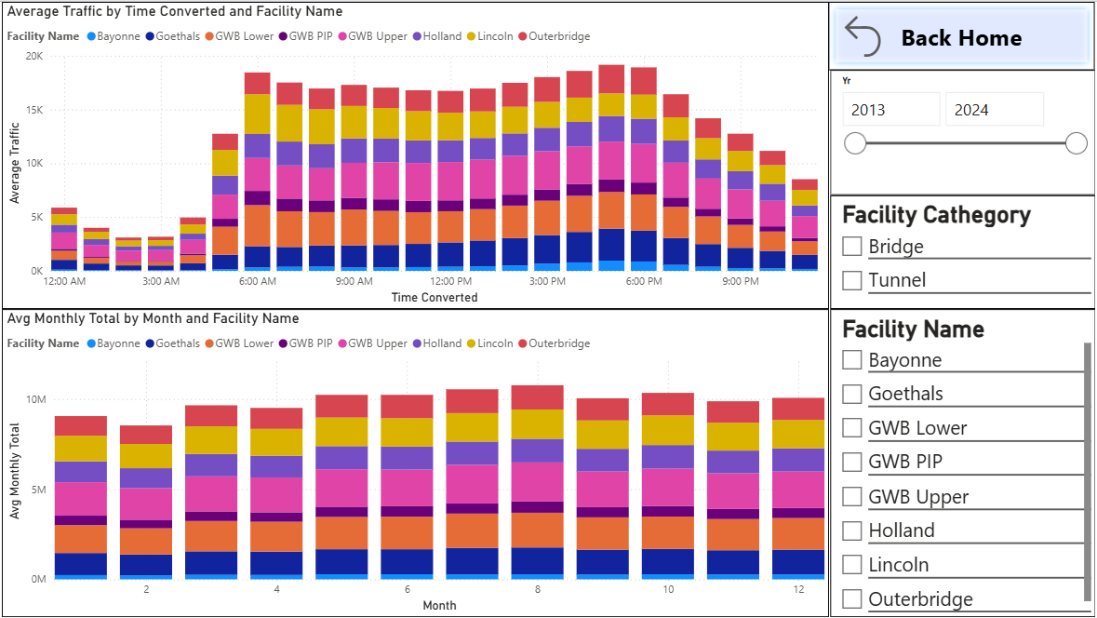

Slide 9
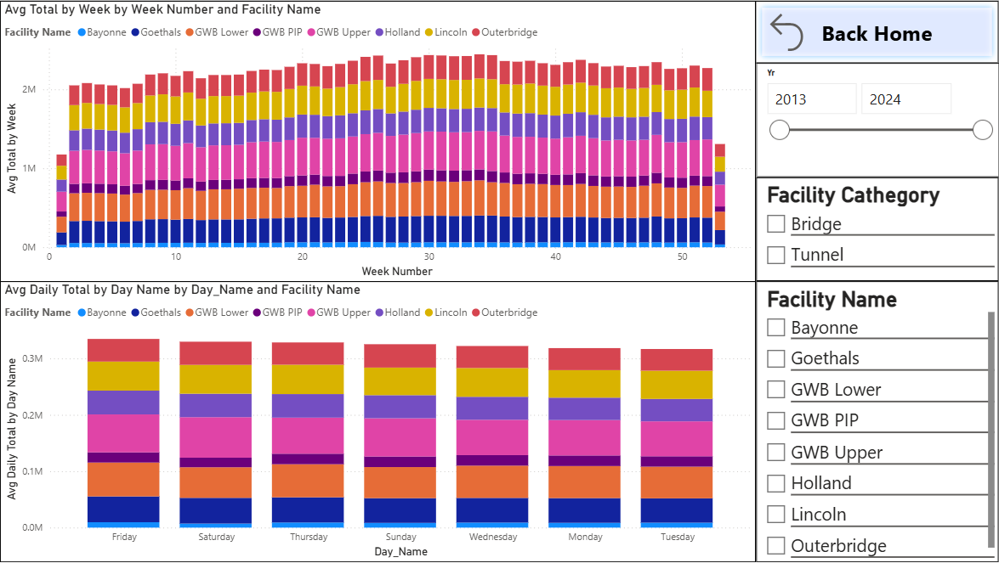

Slide 10
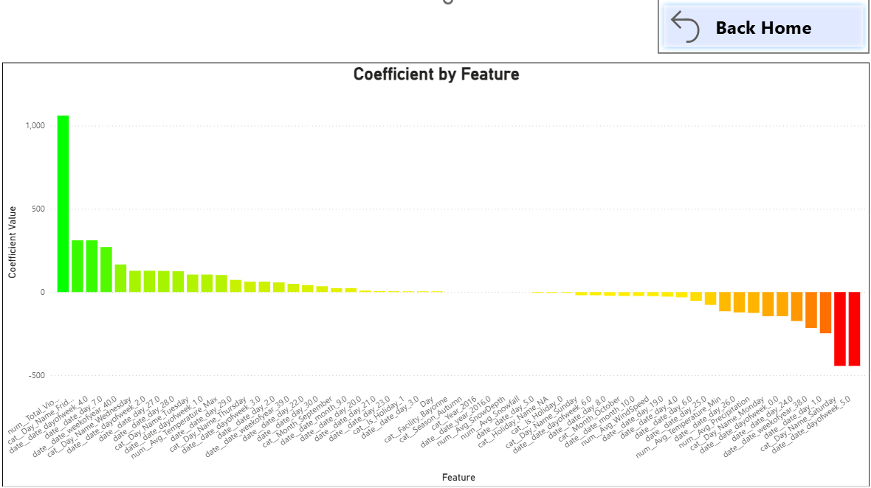

Slide 11
Question 4: Congestion Due to Pricing in 2025
Measuring 2025 pricing effects was challenging due to data limits, but inferential analysis provides insights.
Key Findings
Revenue Breakdown (Jan-May 2025)
No clear driver diversion from tolled facilities due to pricing.
GWB remains the primary traffic corridor and top revenue generator.
High violations correlate with heavy traffic, not revenue shifts.

Slide 12
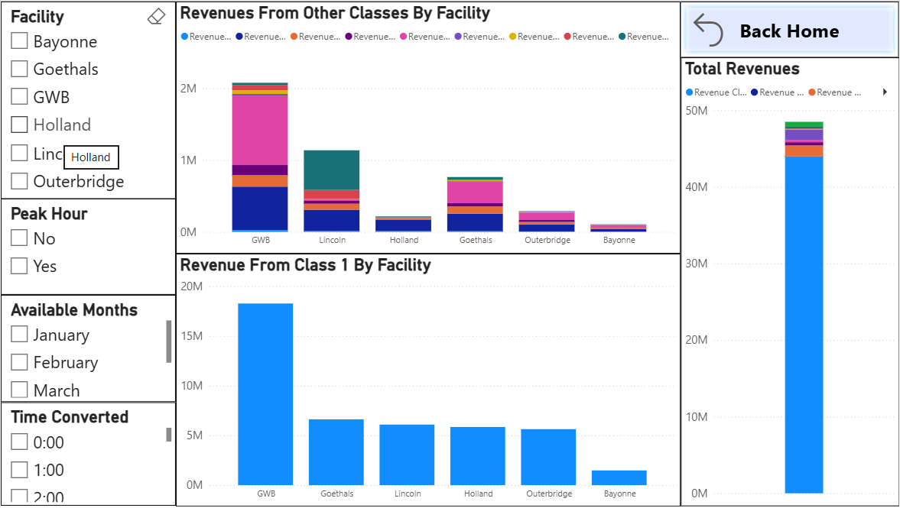

Slide 13
Question 5: Forecasting Facility Usage Beyond 2025
Lincoln Tunnel
Highest Usage: ≈ 2.75M/month
GWB Upper
High, Stable: ≈ 2.4M/month
Holland Tunnel
Consistently High: ≈ 1.75M/month
GWB Lower
Stable: ≈ 1.5M/month
Goethals Bridge
Moderate, Steady: ≈ 1.25M/month
Outerbridge
Low-to-Moderate: ≈ 1.0M/month
Bayonne Bridge
Lowest Usage: ≈ 0.35M/month
Notes:
Time-series frecasts project traffic volumes through April 2028

Slide 14
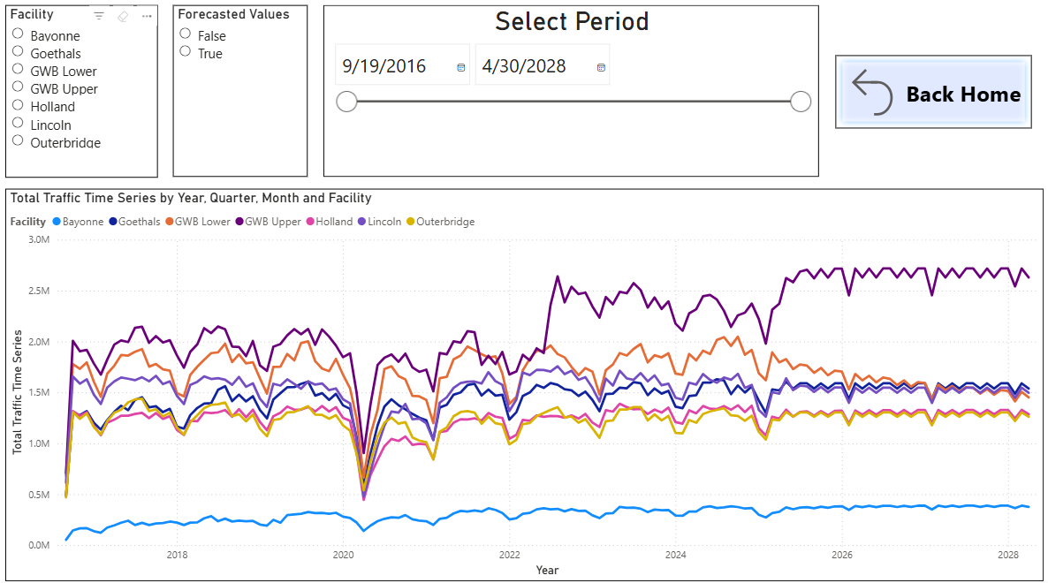

Slide 15
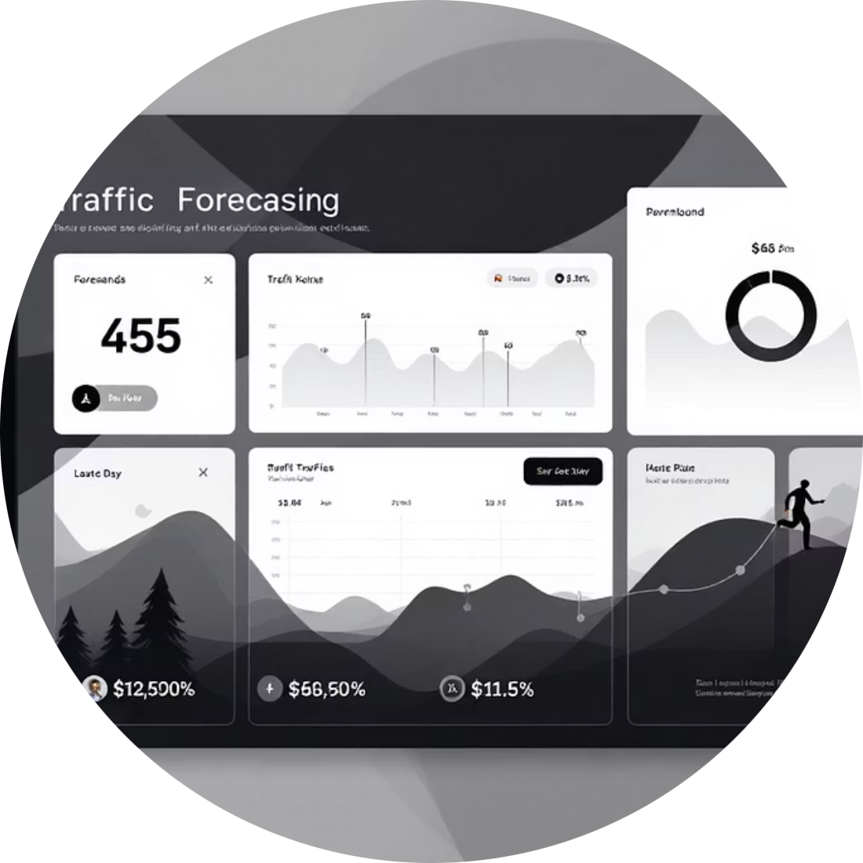


On-Demand Traffic Forecasts
Dynamic, date-specific traffic forecasts via an intuitive web application. No technical expertise required.
Intuitive Interface
Extended Horizons
Automated Insights
Generate predictions for any future date with ease.
Access long-term insights and run operational scenarios.
Receive insights without technical expertise or code.
CLICK HERE TO ACCESS THE APP

Slide 16


Slide 17





Final Recommendations: Strategic Path Forward
Our analysis provides key recommendations for optimizing operations, enhancing planning, and embracing data-driven strategies.
Reinforce High-Demand Corridors
Utilize Forecasting Models Proactively
Enhance Toll Violation Enforcement
Increase staffing and maintenance. Implement real-time congestion management.
Integrate the web app for staffing, incident response, and maintenance planning.
Use violation spikes for enforcement. Prevent bottlenecks and ensure revenue.
Expand Data Collection
Account for Exogenous Factors
Gather historical toll data, origin-destination, and granular logs for better forecasts.
Incorporate external events and policy shifts into future analyses for precision.

